Slide 1
Recommendation System Based on Movie Preference
Team 10 : netFlex

Slide 2
Contents
Introduction
Summary of our last Proposal
Basic Assumptions 1
Basic Assumptions 2
Big picture of our Scenario
Scenario Implementation
Constructing a Movie Database
Movie Data from API source
Constructing an User interface
User Data from Web source
Web Crawling Sample data from Watchapedia
Web Page gathering New Users' Preferences
Prototype
Preprocessing and Inserting Data into DBs
Data Characteristics (Before Preprocessing)
Data Characteristics (After Preprocessing)
[ API source ] Movie Data format
[ Web source ] User Data format
Constructing a recommendation system
Basic Assumption 1 & Collaborative Filtering
Basic Assumption 2 & Contents-based recommendation
Project Demo

Slide 3
Introduction 1
Summary of our last Proposal

Slide 4
Basic Assumptions 1
Those who have similar preferences to movies would leave similar rates on specific movies
Movie1
(이미지)
MAN 1
(이미지)
LIKE
DISLIKE
Movie3
(이미지)
Movie2
(이미지)
MAN 2
(이미지)

Slide 5
Basic Assumptions 1
Those who have similar preferences to movies would leave similar rates on specific movies
Movie1
(이미지)
MAN 1
(이미지)
LIKE
DISLIKE
Movie3
(이미지)
Movie2
(이미지)
MAN 2
(이미지)
Having Similar Preferences

Slide 6
Basic Assumptions 1
Those who have similar preferences to movies would leave similar rates on specific movies
MAN 1
(이미지)
LIKE
DISLIKE
If the other likes
NEW
Movie4
(이미지)
MAN 2
(이미지)
You would also like

Slide 7
Basic Assumptions 1
Those who have similar preferences to movies would leave similar rates on specific movies
MAN 1
(이미지)
LIKE
DISLIKE
If the other dislikes
NEW
Movie4
(이미지)
MAN 2
(이미지)
You would also dislike

Slide 8
Basic Assumptions 2
People tend to like similar movies or TV shows that share the same styles such as genres, topics, actors or filmmakers
Movie1
(이미지)
MAN
(이미지)
If you like these
Movie3
(이미지)
Movie2
(이미지)
Similar movies
You would also like this
Similar
Movie4
(이미지)

Slide 9
Basic Assumptions 2
People tend to like similar movies or TV shows that share the same styles such as genres, topics, actors or filmmakers
Movie1
(이미지)
MAN
(이미지)
If you like these
Movie3
(이미지)
Movie2
(이미지)
Similar movies
You would not like this
dissimilar
Movie4
(이미지)

Slide 10
Introduction 2
Big Picture of our Scenario

Slide 11


Big Picture of our Scenario
Data Source : Movies & User preferences
Periodically updated
Rapid API
Movie Database
Alternative

Slide 12


Big Picture of our Scenario
Data Source : Movies & User preferences
Periodically updated
Rapid API
Movie Database
Alternative
Meta data
Python

Slide 13





Big Picture of our Scenario
Data Source : Movies & User preferences
Updated when new users enroll in
User Interface based on Web
Rate the following videos
Periodically updated
Input
Rapid API
Movie Database
Alternative
Meta data
Python

Slide 14

Big Picture of our Scenario
Data Source : Movies & User preferences
Updated when new users enroll in
User Interface based on Web
Rate the following videos
Periodically updated
Input
Rapid API
Movie Database
Alternative
Meta data
Python
Raw data

Slide 15
Big Picture of our Scenario
Data Source : Movies & User preferences
Updated when new users enroll in
User Interface based on Web
Rate the following videos
Periodically updated
Input
Rapid API
Movie Database
Alternative
Meta data
Python
Raw data
Preprocessing data
In Python Environment

Slide 16


Big Picture of our Scenario
Data Source : Movies & User preferences
Data Warehouse
Updated when new users enroll in
User Interface based on Web
Rate the following videos
Periodically updated
Input
Rapid API
Movie Database
Alternative
Meta data
Python
Raw data
Inserting Data
via Drivers
Preprocessing data
In Python Environment

Slide 17
Big Picture of our Scenario
Data Source : Movies & User preferences
Data Warehouse
Application
Updated when new users enroll in
User Interface based on Web
Recommendation
Service
Rate the following videos
Periodically updated
Input
Rapid API
Movie Database
Alternative
Meta data
Python
Raw data
Inserting Data
via Drivers
Preprocessing data
In Python Environment

Slide 18
Big Picture of our Scenario
Data Source : Movies & User preferences
Data Warehouse
Application
Updated when new users enroll in
User Interface based on Web
Recommendation
Service
Rate the following videos
Periodically updated
Input
Collaborative filtering
Rapid API
Movie Database
Alternative
Meta data
Python
Raw data
Inserting Data
via Drivers
Preprocessing data
In Python Environment

Slide 19
Big Picture of our Scenario
Data Source : Movies & User preferences
Data Warehouse
Application
Updated when new users enroll in
User Interface based on Web
Recommendation
Service
Rate the following videos
Periodically updated
Input
Collaborative filtering
Rapid API
Raw data
Contents-based
Movie Database
Alternative
Meta data
Python
Inserting Data
via Drivers
Preprocessing data
In Python Environment

Slide 20
Big Picture of our Scenario
Data Source : Movies & User preferences
Data Warehouse
Application
Updated when new users enroll in
User Interface based on Web
Recommendation
Service
Rate the following videos
Periodically updated
Input
Collaborative filtering
Rapid API
UNION
Raw data
Contents-based
Movie Database
Alternative
Meta data
Python
Inserting Data
via Drivers
Preprocessing data
In Python Environment

Slide 21
Big Picture of our Scenario
Data Source : Movies & User preferences
Data Warehouse
Application
Updated when new users enroll in
User Interface based on Web
Recommendation
Service
Rate the following videos
Periodically updated
Input
Collaborative filtering
Rapid API
UNION
Raw data
Contents-based
Movie Database
Alternative
Meta data
Python
Inserting Data
via Drivers
Output
Preprocessing data
In Python Environment

Slide 22
Scenario Implementation 1
Constructing a Movie Database

Slide 23
Constructing a Movie Database
Data Source : Movies & User preferences
Data Warehouse
Application
Updated when new users enroll in
User Interface based on Web
Recommendation
Service
Rate the following videos
Periodically updated
Input
Collaborative filtering
Rapid API
UNION
Raw data
Contents-based
Movie Database
Alternative
Meta data
Python
Inserting Data
via Drivers
Output
Preprocessing data
In Python Environment

Slide 24
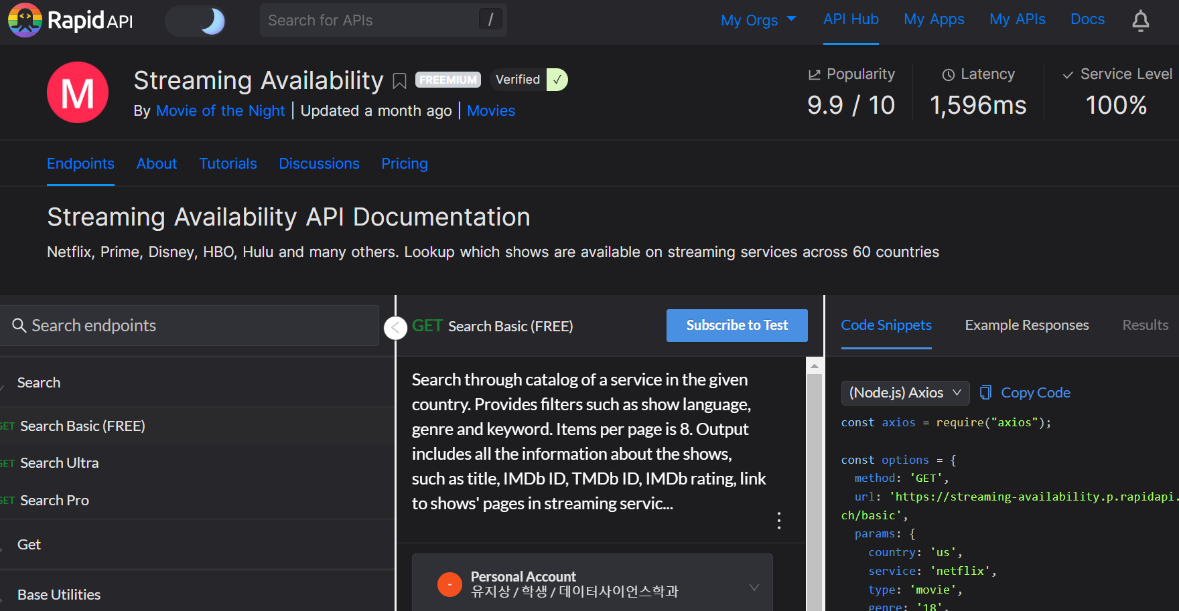
Movie Data from API source
API Source

Slide 25
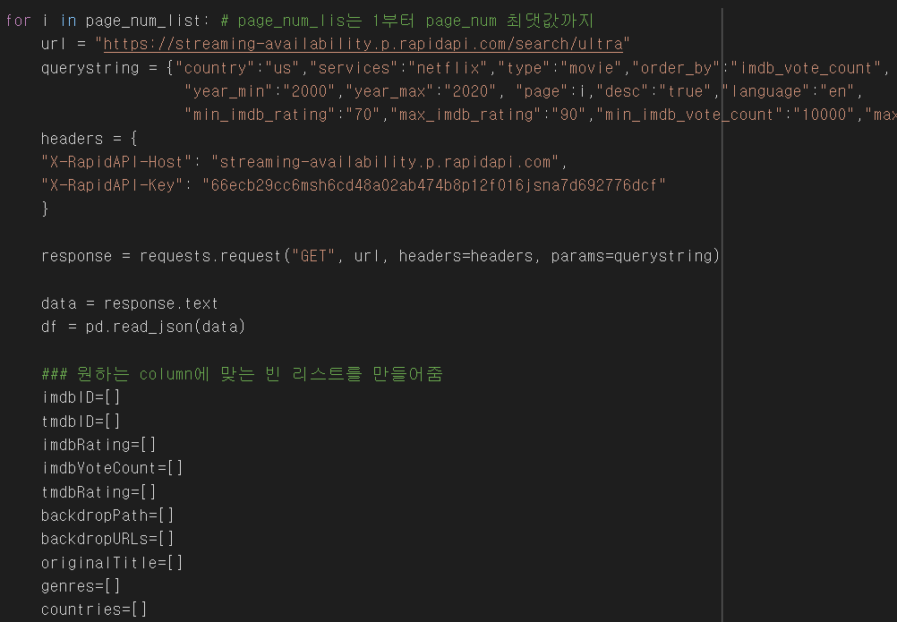
Movie Data from API source
Python code
API Source
Python
Code Sample

Slide 26
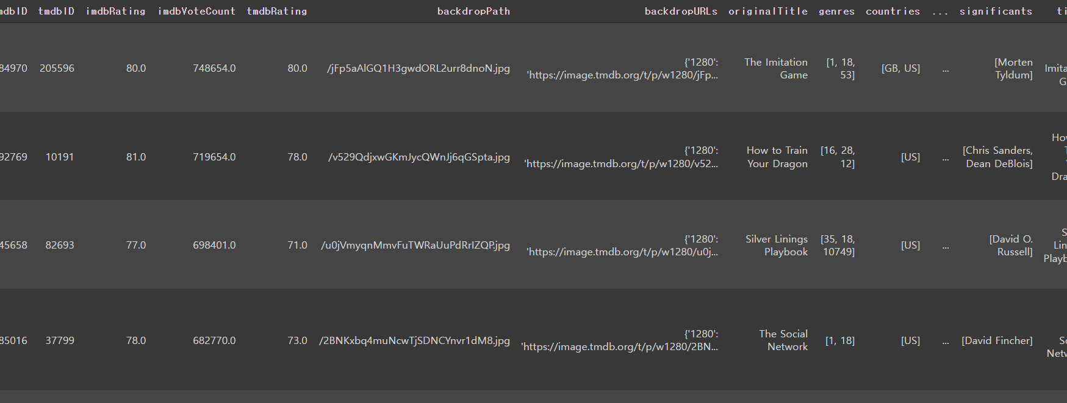
[ API source ] Movie Data format
imdbID | backdropPath | countries | tagline | age | Runtime
imdbRating | backdropURLs | significants | year | streamingInfo | Overview
imdbVoteCount | originalTitle | title | posterPath | originalLanguage | cast
tmdbRating | genres | overview | posterURLs | Columns info
Sample data

Slide 27
Scenario Implementation 2
Constructing an User interface

Slide 28
Constructing an User interface
Data Source : Movies & User preferences
Data Warehouse
Application
Updated when new users enroll in
User Interface based on Web
Recommendation
Service
Rate the following videos
Periodically updated
Input
Collaborative filtering
Rapid API
UNION
Raw data
Contents-based
Movie Database
Alternative
Meta data
Python
Inserting Data
via Drivers
Output
Preprocessing data
In Python Environment

Slide 29
User Data from Web source
Sample Data to run the project
Survey Data from our Web page

Slide 30
User Data from Web source
Get the sample data
by Web Crawling from Watchapedia
Sample Data to run the project
Survey Data from our Web page

Slide 31

Web Crawling Sample data from Watchapedia
[ API source ] Movie Data format
Python code
imdbID | backdropPath | countries | tagline | age | Runtime
imdbRating | backdropURLs | significants | year | streamingInfo | Overview
imdbVoteCount | originalTitle | title | posterPath | originalLanguage | cast
tmdbRating | genres | overview | posterURLs | Columns info
Python

Slide 32

Web Crawling Sample data from Watchapedia
[ API source ] Movie Data format
Python code
imdbID | backdropPath | countries | tagline | age | Runtime
imdbRating | backdropURLs | significants | year | streamingInfo | Overview
imdbVoteCount | originalTitle | title | posterPath | originalLanguage | cast
tmdbRating | genres | overview | posterURLs | Columns info
Python
Search & Find watchaID
Get 10 Reviews
& Identify the reviewers

Slide 33
Web Crawling Sample data from Watchapedia
[ API source ] Movie Data format
Python code
imdbID | backdropPath | countries | tagline | age | Runtime
imdbRating | backdropURLs | significants | year | streamingInfo | Overview
imdbVoteCount | originalTitle | title | posterPath | originalLanguage | cast
tmdbRating | genres | overview | posterURLs | Columns info
Python
Search & Find watchaID
Crawl their Preferences
To Movies/Actors/Directors
Get 10 Reviews
& Identify the reviewers

Slide 34
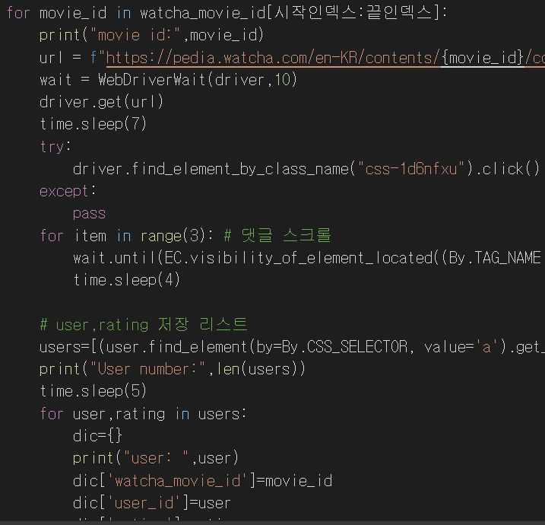
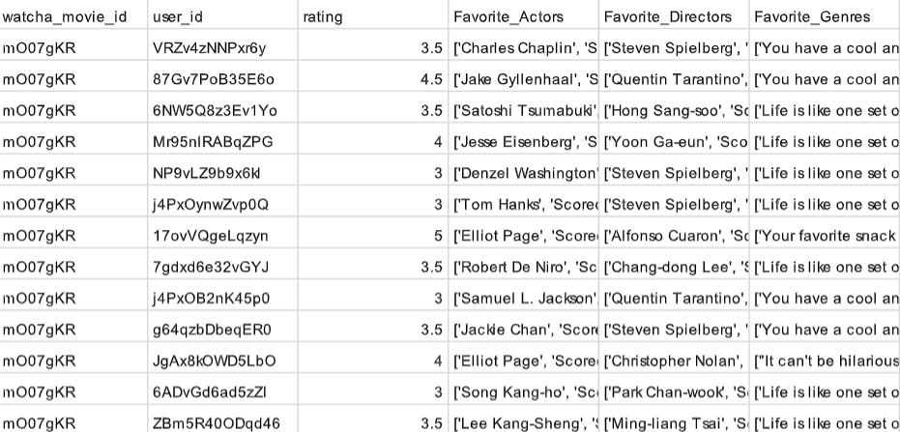
Python code
Python
Code Sample
Sample data

Slide 35
New User’s Data from Web source
Sample Data to run the project
Construct our own Web page
to gather around new users’ preferences data
Survey Data from our Web page

Slide 36
Web Page gathering New Users’ Preferences
Q : What kind of Info do we need?
User_ID
List of Movies to rate
Ratings

Slide 37
Web Page gathering New Users’ Preferences
Q : What kind of Info do we need?
User_ID
List of Movies to rate
Ratings
Functions to implement
Enrollment & Login
Survey of Preferences

Slide 38

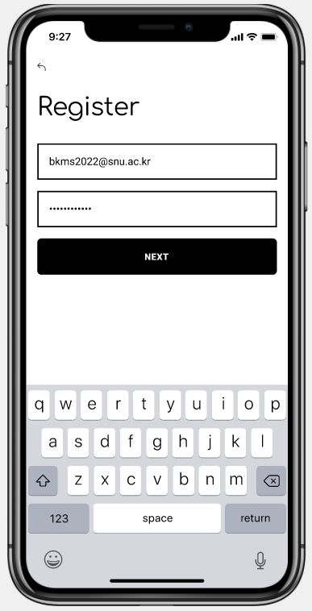

Prototype

Slide 39
Survey of Preferences
Recommended Movies
INPUT
OUTPUT

Slide 40
Scenario Implementation 3
Preprocessing and Inserting Data into DBs

Slide 41
Preprocessing and Inserting Data into DBs
Data Source : Movies & User preferences
Data Warehouse
Application
Updated when new users enroll in
User Interface based on Web
Recommendation
Service
Rate the following videos
Periodically updated
Input
Collaborative filtering
Rapid API
UNION
Raw data
Contents-based
Movie Database
Alternative
Meta data
Python
Inserting Data
via Drivers
Output
Preprocessing data
In Python Environment

Slide 42
Data Characteristics (Before Preprocessing)
[ API source ] Movie Data format
imdbID | backdropPath | countries | tagline | age | Runtime
imdbRating | backdropURLs | significants | year | streamingInfo | Overview
imdbVoteCount | originalTitle | title | posterPath | originalLanguage | cast
tmdbRating | genres | overview | posterURLs | Columns info
[ Web source ] User Data format (Pivot Table)
User_ID | Candidate4_ID | … | …
Candidate1_ID | Candidate5_ID | … | …
Candidate2_ID | Candidate6_ID | … | Candidate(last)_ID
Candidate3_ID | Candidate7_ID | … | Columns info

Slide 43
Data Characteristics (After Preprocessing)
[ API source ] Movie Data format
movie_ID | significants | genres | year | cast
title | countries | age | Columns info | Columns info
[ Web source ] User Data format (Pivot Table)
User_ID | Candidate4_ID | … | …
Candidate1_ID | Candidate5_ID | … | …
Candidate2_ID | Candidate6_ID | … | Candidate(last)_ID
Candidate3_ID | Candidate7_ID | … | Columns info

Slide 44
Data Characteristics (After Preprocessing)
Periodically Updated
in the Background
[ API source ] Movie Data format
movie_ID | significants | genres | year | cast
title | countries | age | Columns info | Columns info
Continuously Updated
when a new user
enrolls in our service
[ Web source ] User Data format (Pivot Table)
User_ID | Candidate4_ID | … | …
Candidate1_ID | Candidate5_ID | … | …
Candidate2_ID | Candidate6_ID | … | Candidate(last)_ID
Candidate3_ID | Candidate7_ID | … | Columns info

Slide 45
[ API source ] Movie Data format
movie_ID | significants | genres | year | cast
title | countries | age | Columns info | Columns info
Python
Big Query
Driver
Python
NEO4J Driver
Python
Python

Slide 46
[ API source ] Movie Data format
movie_ID | significants | genres | year | cast
title | countries | age | Columns info | Columns info
CREATE ACTOR
Actor
Python
NEO4J Driver
Python
Director
PLAY
DIRECT
CREATE DIRECTOR
Movie
CREATE MOVIE

Slide 47
Member Variable
→ name
CREATE ACTOR
Actor
Director
PLAY
DIRECT
CREATE DIRECTOR
Movie
CREATE MOVIE

Slide 48
Member Variable
→ name
CREATE ACTOR
Actor
Member Variable
→ name
Director
PLAY
DIRECT
CREATE DIRECTOR
Movie
CREATE MOVIE

Slide 49
Member Variable
→ name
CREATE ACTOR
Actor
Member Variable
→ name
Director
PLAY
Member Variable
id
year
runtime
title
genre
countries
age
original_lan
DIRECT
CREATE DIRECTOR
Movie
CREATE MOVIE

Slide 50
[ Web source ] User Data format (Pivot Table)
User_ID | Candidate4_ID | … | …
Candidate1_ID | Candidate5_ID | … | …
Candidate2_ID | Candidate6_ID | … | Candidate(last)_ID
Candidate3_ID | Candidate7_ID | … | Columns info
Python
Big Query
Driver
Python
NEO4J Driver
Python
Python

Slide 51
[ Web source ] User Data format (Pivot Table)
User_ID | Candidate4_ID | … | …
Candidate1_ID | Candidate5_ID | … | …
Candidate2_ID | Candidate6_ID | … | Candidate(last)_ID
Candidate3_ID | Candidate7_ID | … | Columns info
CREATE ACTOR
Actor
LIKE
Python
NEO4J Driver
LIKE
Python
Director
PLAY
User
DIRECT
LIKE
CREATE DIRECTOR
Movie
CREATE MOVIE

Slide 52
Member Variable
→ likeness
CREATE ACTOR
Actor
LIKE
LIKE
Director
PLAY
User
DIRECT
LIKE
CREATE DIRECTOR
Movie
CREATE MOVIE

Slide 53
Member Variable
→ likeness
CREATE ACTOR
Actor
LIKE
By this process
LIKE
Director
PLAY
User
For each actor & director
DIRECT
LIKE
Accumulated weights
(ratings for movies)
CREATE DIRECTOR
Movie
CREATE MOVIE
Min-Max Scaler
to fit the value
In the range of 0~100

Slide 54
Member Variable
→ likeness
CREATE ACTOR
Actor
LIKE
LIKE
Director
PLAY
User
DIRECT
LIKE
Member Variable
→ id
CREATE DIRECTOR
Movie
CREATE MOVIE

Slide 55
[ API source ] Movie Data format
movie_ID | significants | genres | year | cast
title | countries | age | Columns info | Columns info
[ Web source ] User Data format (Pivot Table)
User_ID | Candidate4_ID | … | …
Candidate1_ID | Candidate5_ID | … | …
Candidate2_ID | Candidate6_ID | … | Candidate(last)_ID
Candidate3_ID | Candidate7_ID | … | Columns info
Python
Big Query
Driver
Preprocess
Python

Slide 56
[ API source ] Movie Data format
movie_ID | significants | genres | year | cast
title | countries | age | Columns info | Columns info
[ Web source ] User Data format (Pivot Table)
User_ID | Candidate4_ID | … | …
Candidate1_ID | Candidate5_ID | … | …
Candidate2_ID | Candidate6_ID | … | Candidate(last)_ID
Candidate3_ID | Candidate7_ID | … | Columns info
Schema Design
movie_ID | STRING
title | STRING
user_ID | STRING
rating | FLOAT
Python
Big Query
Driver
Preprocess
Python

Slide 57
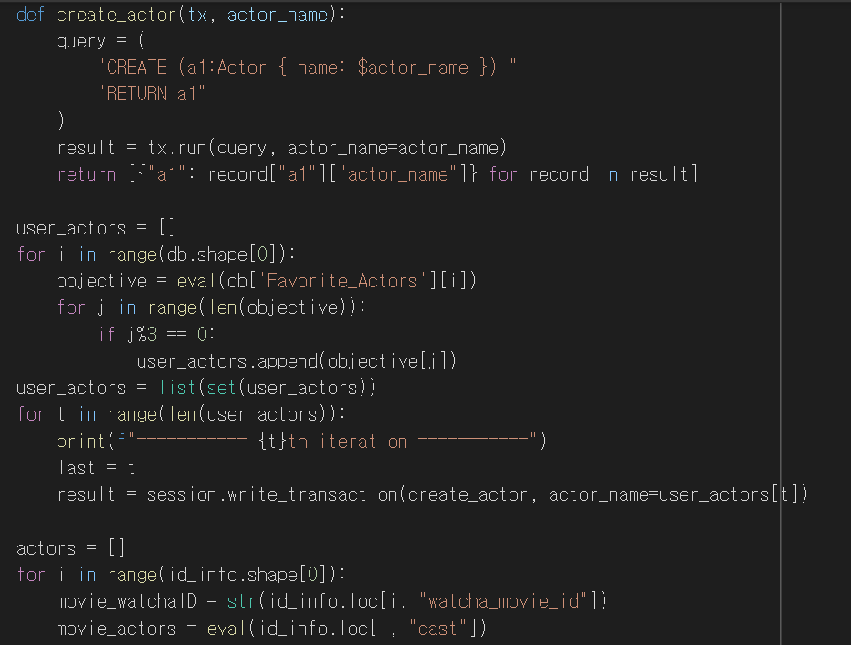
Python NEO4J Driver
Python
Code Sample

Slide 58
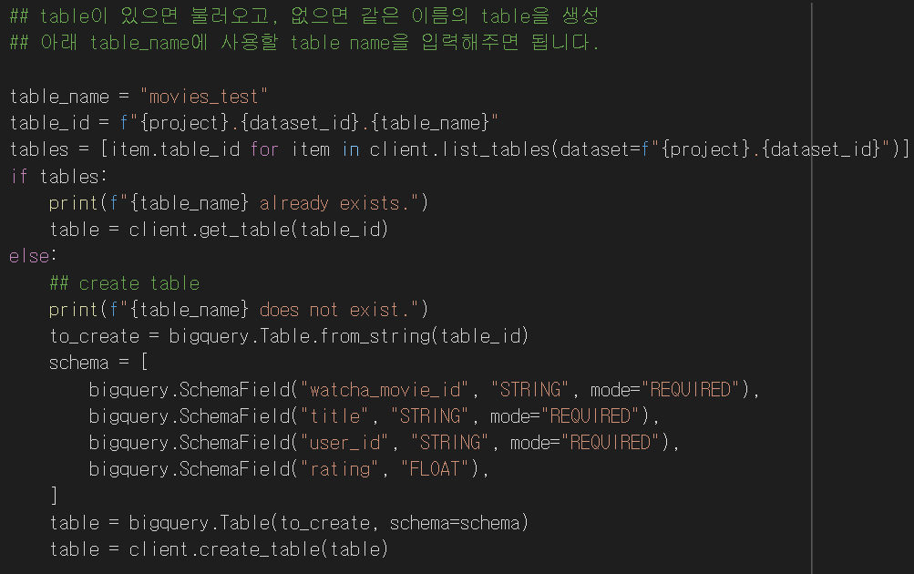
Python Big Query Driver
Python
Code Sample

Slide 59
Scenario Implementation 4
Constructing a recommendation system

Slide 60
Constructing a recommendation system
Data Source : Movies & User preferences
Data Warehouse
Application
Updated when new users enroll in
User Interface based on Web
Recommendation
Service
Rate the following videos
Periodically updated
Input
Collaborative filtering
Rapid API
UNION
Raw data
Contents-based
Movie Database
Alternative
Meta data
Python
Inserting Data
via Drivers
Output
Preprocessing data
In Python Environment

Slide 61
Basic Assumption 1
LIKE
DISLIKE
Movie1
(이미지)
MAN 1
(이미지)
MAN 1
(이미지)
If the other likes
NEW
Movie4
(이미지)
Movie3
(이미지)
MAN 2
(이미지)
Movie2
(이미지)
MAN 2
(이미지)
You would also like
Having Similar Preferences

Slide 62
Basic Assumption 1
corresponds to
Collaborative Filtering
LIKE
DISLIKE
Movie1
(이미지)
MAN 1
(이미지)
MAN 1
(이미지)
If the other likes
NEW
Movie4
(이미지)
Movie3
(이미지)
MAN 2
(이미지)
Movie2
(이미지)
MAN 2
(이미지)
You would also like
Having Similar Preferences

Slide 63
Basic Assumption 1
corresponds to
Collaborative Filtering
LIKE
DISLIKE
Movie1
(이미지)
MAN 1
(이미지)
MAN 1
(이미지)
If the other likes
NEW
Movie4
(이미지)
Movie3
(이미지)
MAN 2
(이미지)
Movie2
(이미지)
MAN 2
(이미지)
You would also like
Having Similar Preferences
Collaborative-Filtering Machine Learning Query

Slide 64
Basic Assumption 2
Similar movies
Similar movies
Movie1
(이미지)
MAN
(이미지)
If you like these
Movie1
(이미지)
MAN
(이미지)
If you like these
Movie3
(이미지)
Movie2
(이미지)
Movie3
(이미지)
Movie2
(이미지)
You would also like this
You would not like this
Similar
dissimilar
Movie4
(이미지)
Movie4
(이미지)

Slide 65
Basic Assumption 2
corresponds to
Contents-based
Recommendation
Similar movies
Similar movies
Movie1
(이미지)
MAN
(이미지)
If you like these
Movie1
(이미지)
MAN
(이미지)
If you like these
Movie3
(이미지)
Movie2
(이미지)
Movie3
(이미지)
Movie2
(이미지)
You would also like this
You would not like this
Similar
dissimilar
Movie4
(이미지)
Movie4
(이미지)

Slide 66
Basic Assumption 2
corresponds to
Contents-based
Recommendation
Similar movies
Similar movies
Movie1
(이미지)
MAN
(이미지)
If you like these
Movie1
(이미지)
MAN
(이미지)
If you like these
Movie3
(이미지)
Movie2
(이미지)
Movie3
(이미지)
Movie2
(이미지)
You would also like this
You would not like this
Similar
dissimilar
Movie4
(이미지)
Movie4
(이미지)
CQL : Cypher Query

Slide 67
Recommendation 1 : Collaborative Filtering
Collaborative-filtering
Machine Learning Query
Detour !
Return !
Implement Collaborative-filtering
algorithms
Python

Slide 68
Implement Collaborative-filtering
algorithms
Python
movie_ID | STRING
title | STRING
user_ID | STRING
rating | FLOAT

Slide 69
Implement Collaborative-filtering
algorithms
Python
NULL ➔ 0
PIVOT TABLE | user_1 | user_2 | … | user_last
movie_1 | 0 | rating | … | rating
movie_2 | rating | 0 | … | 0
movie_3 | rating | 0 | … | rating
… | … | … | … | …
movie_last | 0 | rating | … | rating
movie_ID | STRING
title | STRING
user_ID | STRING
rating | FLOAT
Pivotized

Slide 70
Implement Collaborative-filtering
algorithms
Python
New User
NULL ➔ 0
PIVOT TABLE | user_1 | user_2 | … | user_last
movie_1 | 0 | rating | … | rating
movie_2 | rating | 0 | … | 0
movie_3 | rating | 0 | … | rating
… | … | … | … | …
movie_last | 0 | rating | … | rating
movie_ID | STRING
title | STRING
user_ID | STRING
rating | FLOAT
Pivotized

Slide 71
Implement Collaborative-filtering
algorithms
Python
New User
NULL ➔ 0
PIVOT TABLE | user_1 | user_2 | … | user_last
movie_1 | 0 | rating | … | rating
movie_2 | rating | 0 | … | 0
movie_3 | rating | 0 | … | rating
… | … | … | … | …
movie_last | 0 | rating | … | rating
movie_ID | STRING
title | STRING
user_ID | STRING
rating | FLOAT
Pivotized
SVD
Extracting Latent Factors

Slide 72
Implement Collaborative-filtering
algorithms
Python
New User
NULL ➔ 0
PIVOT TABLE | user_1 | user_2 | … | user_last
movie_1 | 0 | rating | … | rating
movie_2 | rating | 0 | … | 0
movie_3 | rating | 0 | … | rating
… | … | … | … | …
movie_last | 0 | rating | … | rating
movie_ID | STRING
title | STRING
user_ID | STRING
rating | FLOAT
Pivotized
SVD
Extracting Latent Factors
Prediction
0 → rating

Slide 73
Implement Collaborative-filtering
algorithms
Python
New User
NULL ➔ 0
PIVOT TABLE | user_1 | user_2 | … | user_last
movie_1 | rating | rating | … | rating
movie_2 | rating | rating | … | rating
movie_3 | rating | rating | … | rating
… | … | … | … | …
movie_last | rating | rating | … | rating
movie_ID | STRING
title | STRING
user_ID | STRING
rating | FLOAT
Pivotized
SVD
Extracting Latent Factors
Prediction
0 → rating

Slide 74
Implement Collaborative-filtering
algorithms
Python
New User
NULL ➔ 0
PIVOT TABLE | user_1 | user_2 | … | user_last
movie_1 | rating | rating | … | rating
movie_2 | rating | rating | … | rating
movie_3 | rating | rating | … | rating
… | … | … | … | …
movie_last | rating | rating | … | rating
movie_ID | STRING
title | STRING
user_ID | STRING
rating | FLOAT
Pivotized
Recommended
Movie list
SVD
Extracting Latent Factors
Output
ORDER By rating DESC
Prediction
0 → rating

Slide 75
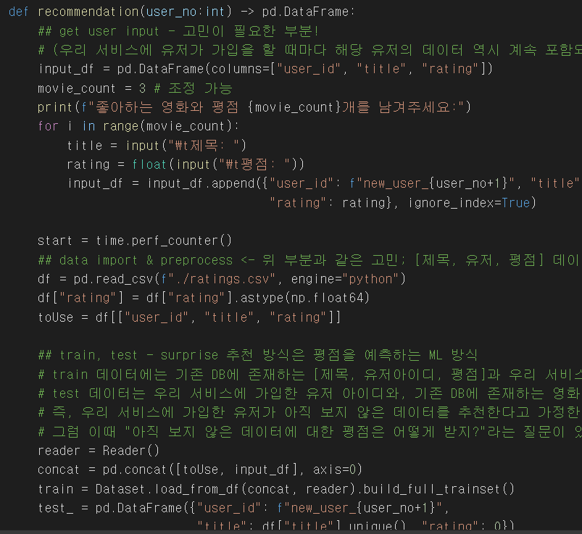
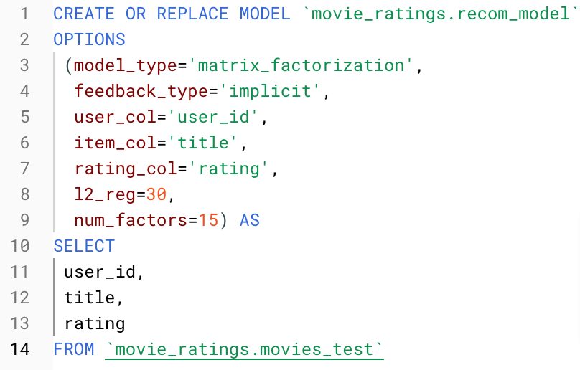
Collaborative filtering
(Big query ver)
Collaborative filtering
(Python ver)
Python
SQL sentence
Code Sample

Slide 76
Recommendation 2 : Contents-based
Recommend What?
Movies that preferred actors starred
Movies that preferred directors directed
CQL : Cypher Query
Movies that both the preferred actors and directors are related with
Movies that other users
who are similar to new users liked

Slide 77
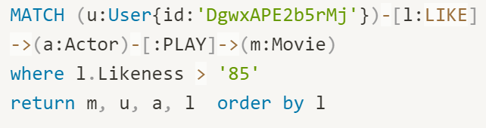
CQL : Cypher Query 1
Movies that preferred actors starred
Director
Actor
Movie
User

Slide 78
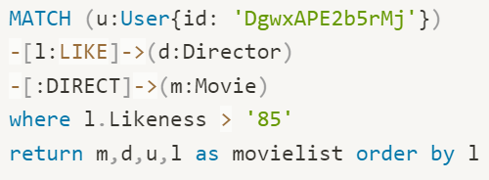
CQL : Cypher Query 2
Movies that preferred directors directed
Director
Actor
Movie
User

Slide 79
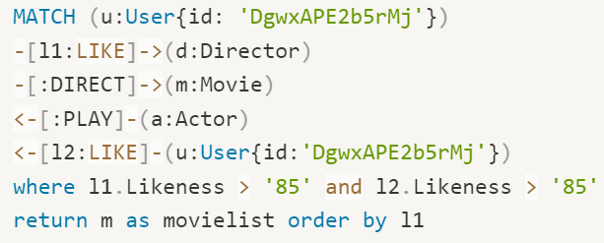
CQL : Cypher Query 3
Movies that both the preferred actors and directors are related with
Director
Actor
Movie
User

Slide 80

CQL : Cypher Query 4
Movies that other users who are similar to new users liked
Director
Actor
Movie
User

Slide 81
Project Demo

Slide 82
시연 영상 삽입

Slide 83
Thank you!

